Slide 1

WOSA
PINOT NOIR

Slide 2
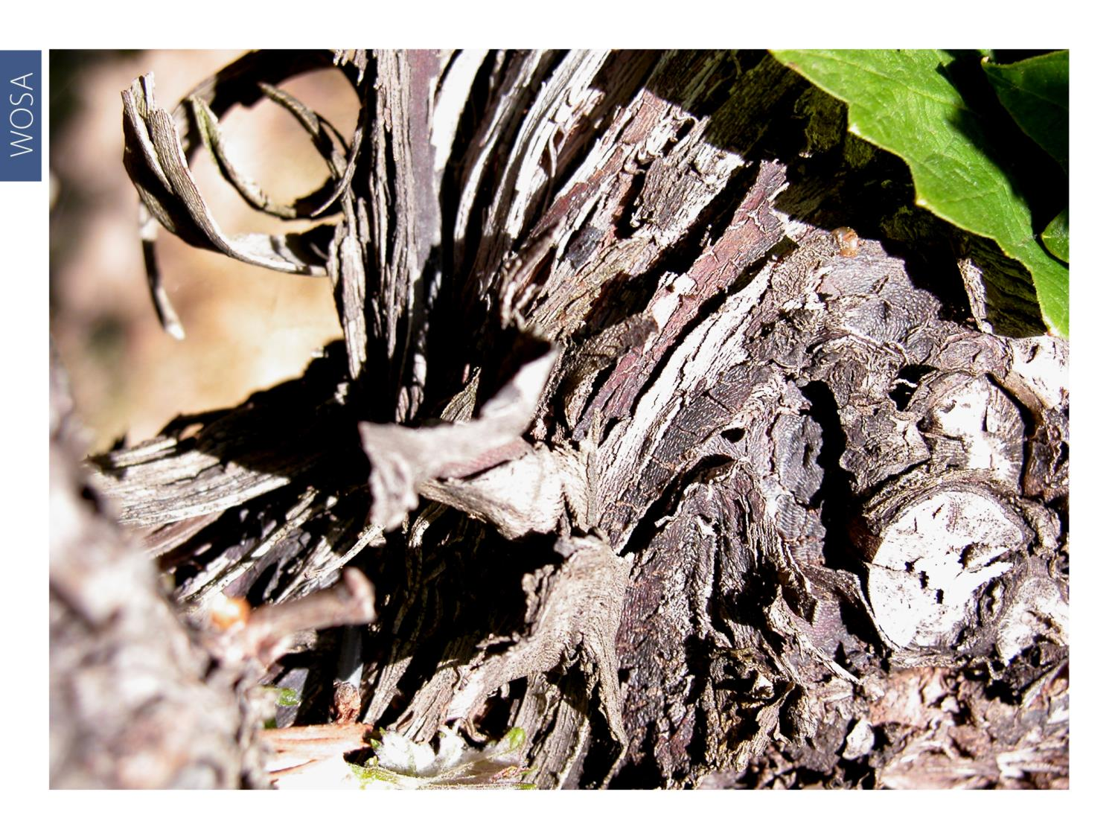
WOSA
Notes:
Pinot Noir, one of the oldest wine grape varieties in the world, is thought to be among the first cultivated offspring of the wild vine.

Slide 3
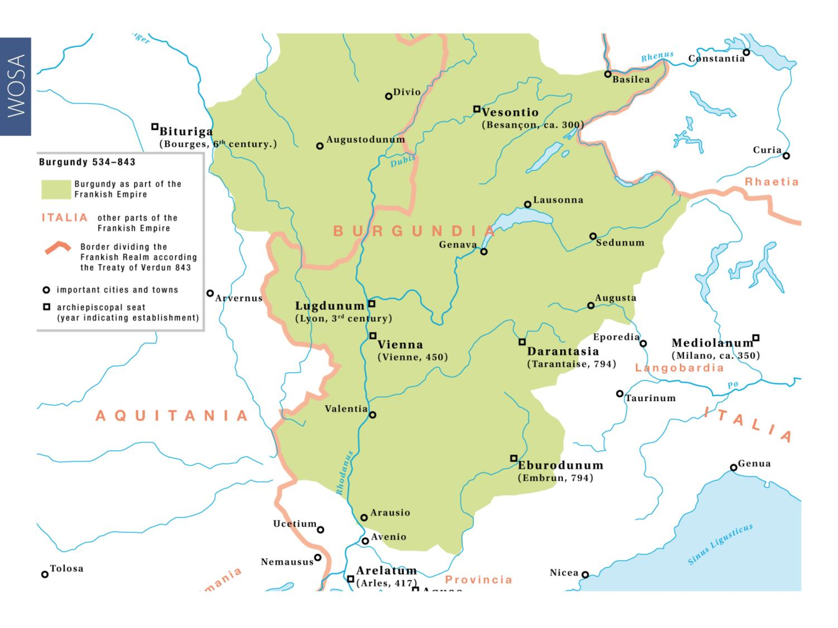
WOSA
Notes:
Pinot Noir is renowned in the Burgundy and Champagne appellations of France.

Slide 4
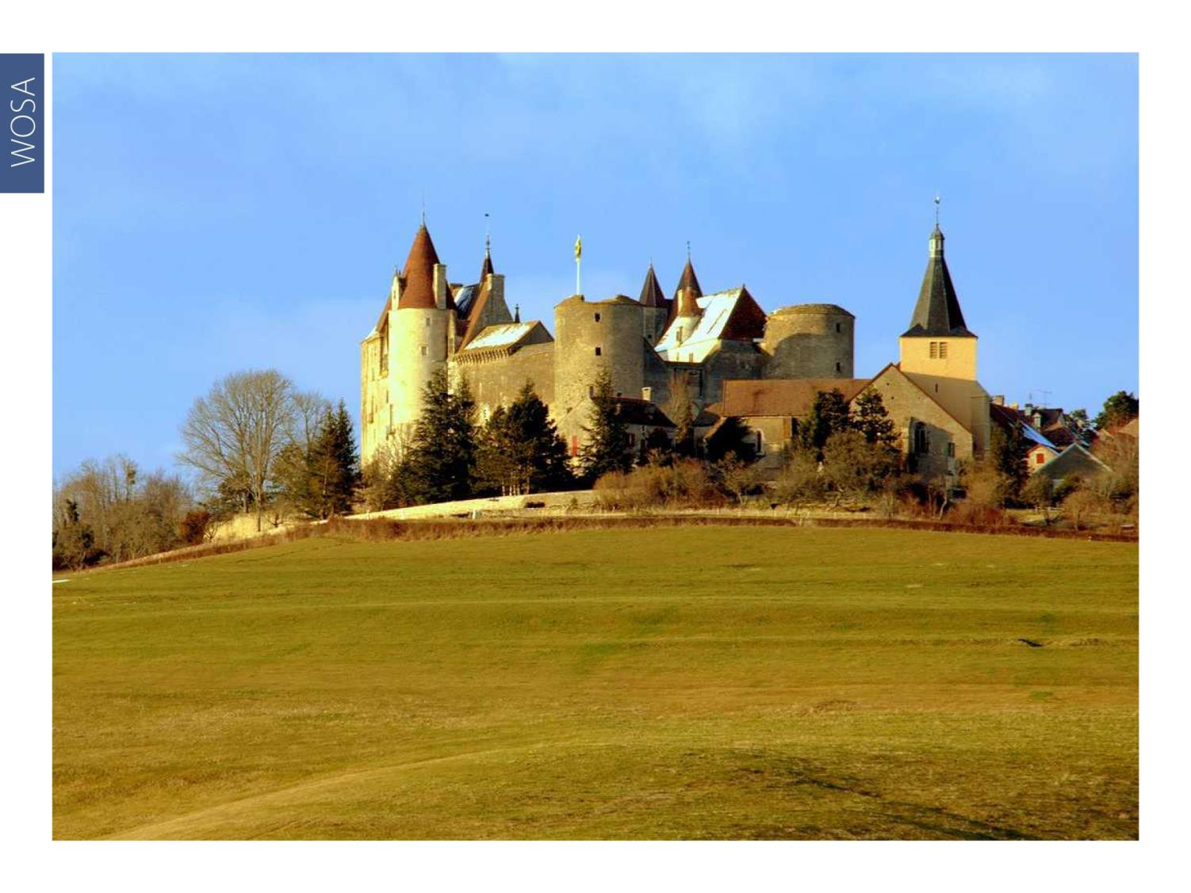
WOSA
Notes:
Pinot is widely believed to be indigenous to the Côte d’Or (slope of gold) in Burgundy.

Slide 5

WOSA
Notes:
Known as the king of Burgundy, Pinot is notoriously difficult to grow elsewhere and is thus called ‘the heartbreak grape’.

Slide 6
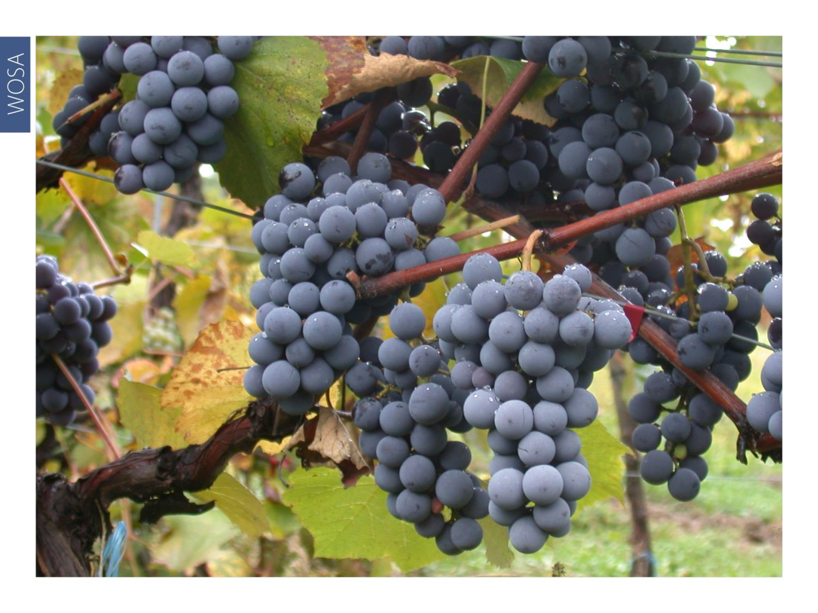
WOSA
Notes:
In 1925, Professor Abraham Perold crossed Pinot Noir with Cinsaut (Hermitage) to develop seeds for growing the Pinotage grape.

Slide 7
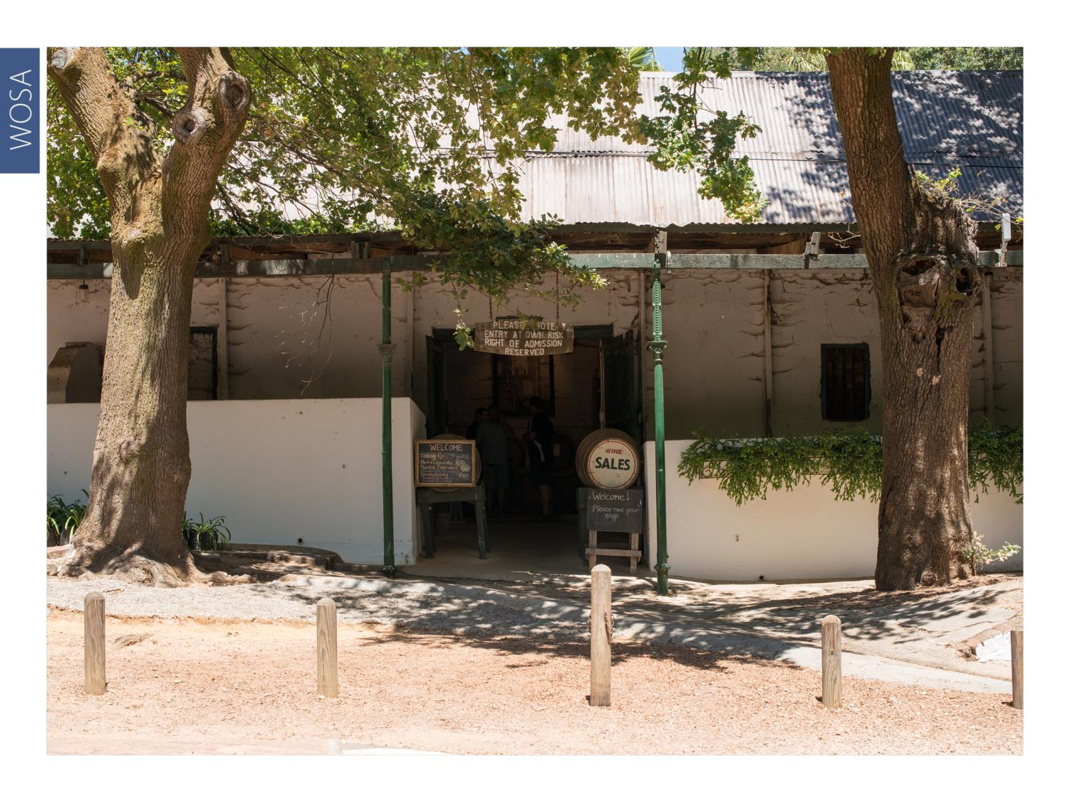
WOSA
Notes:
In South Africa, the first Pinot Noir vines were planted on Stellenbosch estate Muratie in 1927, while one of the leading producers of the modern era, namely Walker Bay property Hamilton Russell Vineyards, celebrated 40 consecutive vintages in 2020.

Slide 8
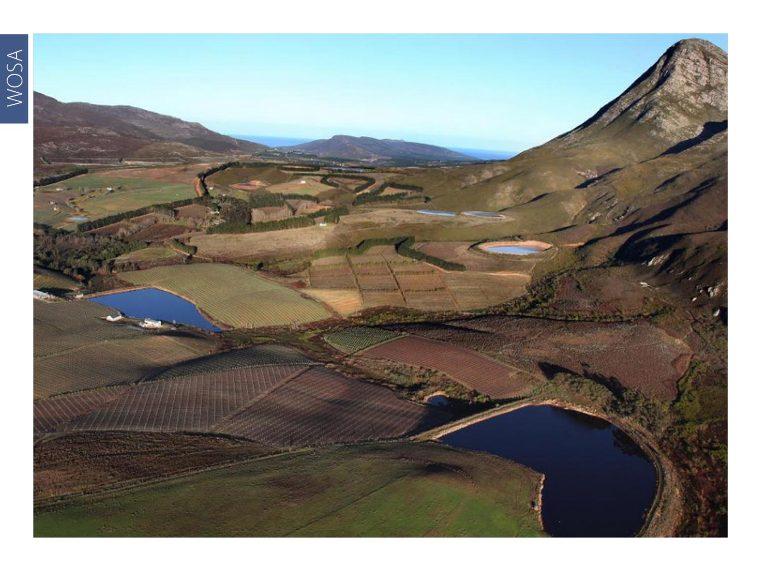
WOSA
Notes:
Pinot Noir is now the seventh most planted red-wine variety in South Africa, with total plantings at the end of 2023 accounting for 1 212 ha (1.4% of the national vineyard).

Slide 9
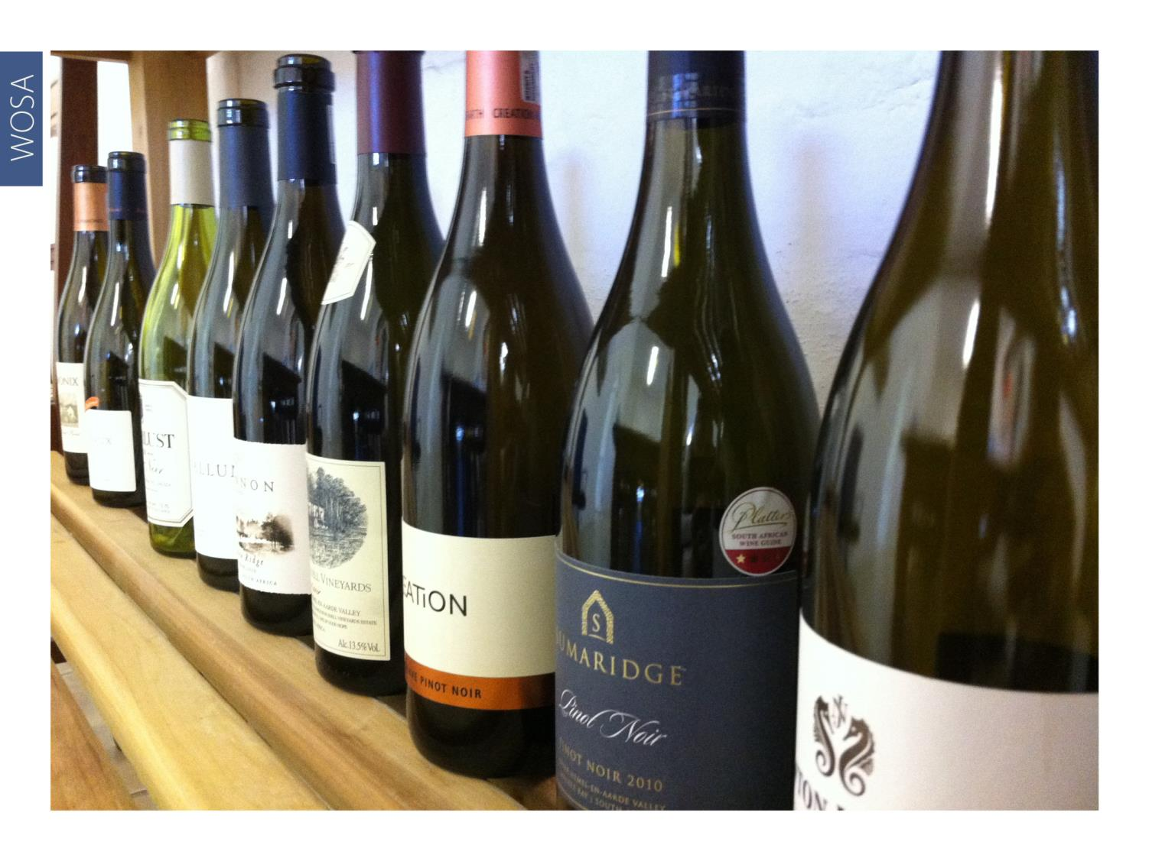
WOSA
Notes:
Although plantings of the variety remain small, these have increased considerably since 1997 and significant quality improvements have been noted in recent years.

Slide 10
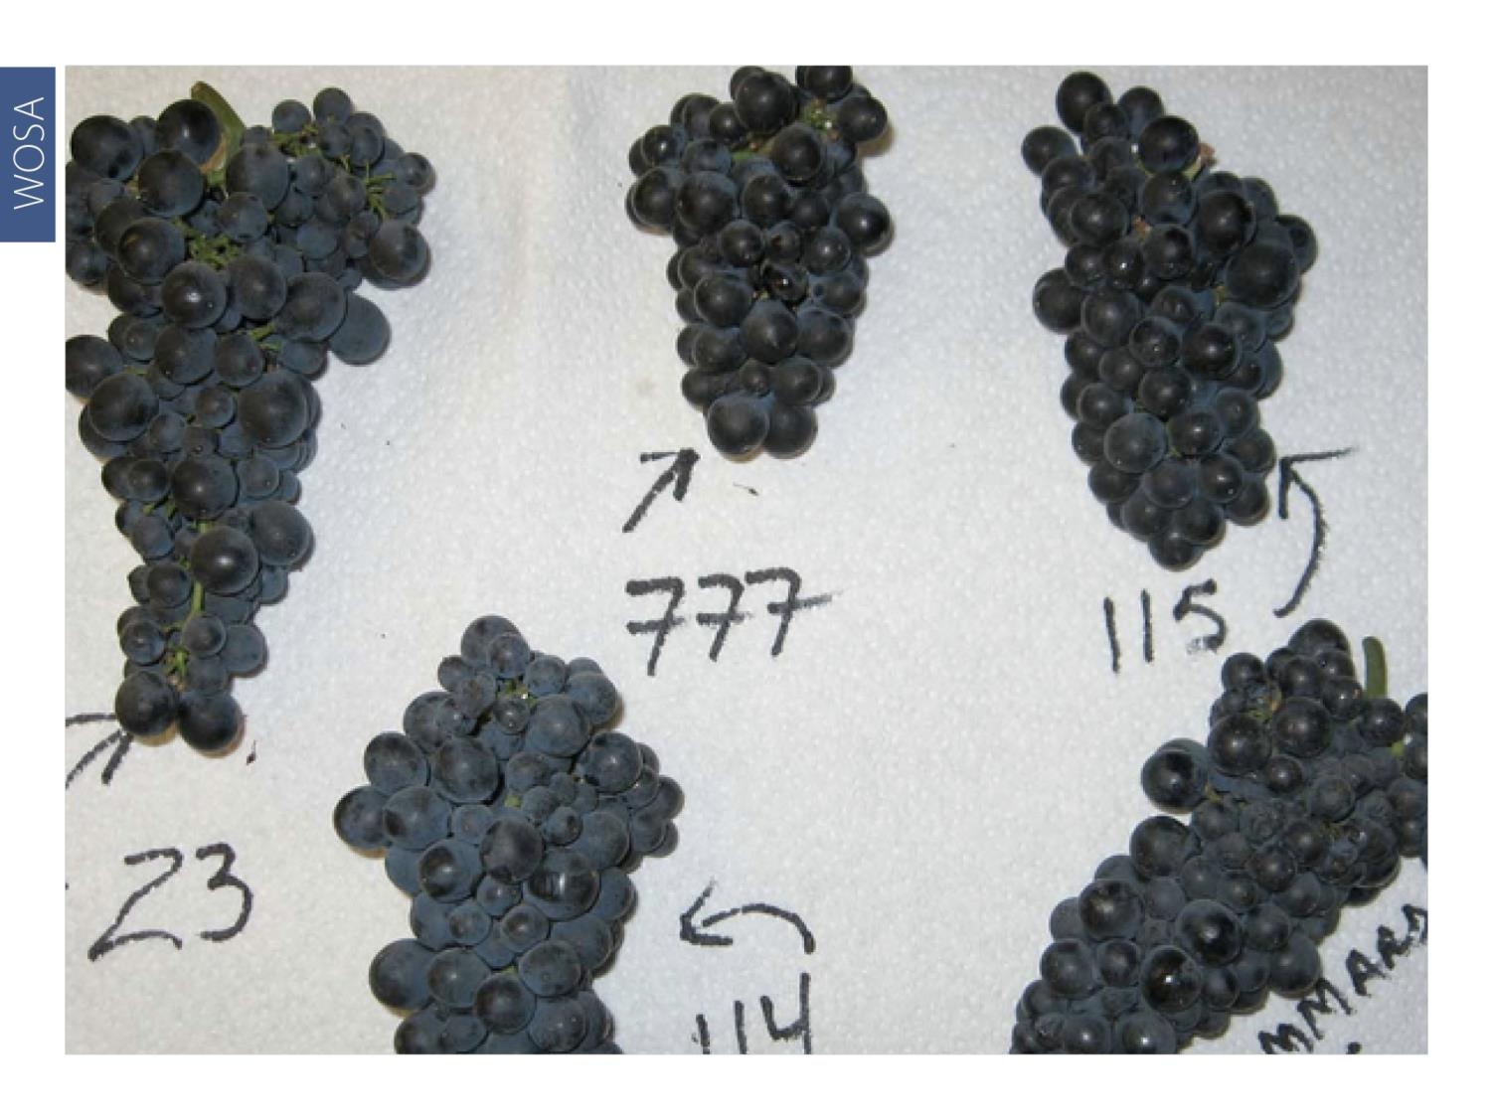
WOSA
Notes:
The clones that were generally planted in the early years were BK5, then 113 and 115, and more recently 667 and 777.

Slide 11
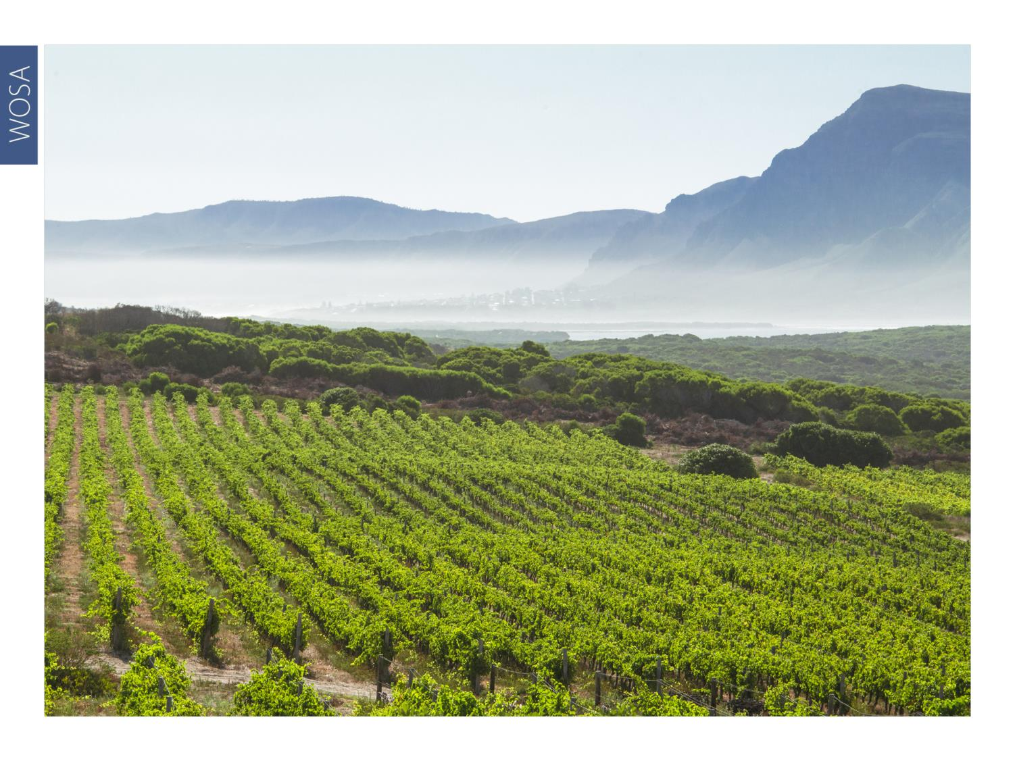
WOSA
Notes:
Although not yet widely planted, this noble variety is now producing excellent wines in the cooler viticultural areas of South Africa such as Elgin and Walker Bay.

Slide 12
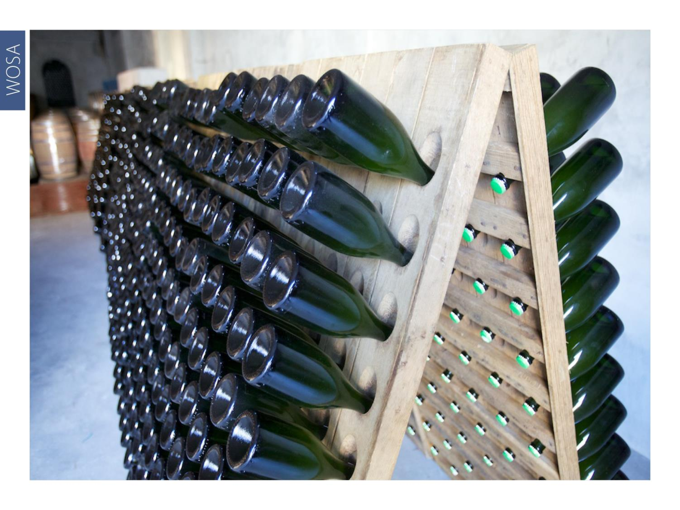
WOSA
Notes:
A large proportion of Pinot Noir is used in Cap Classique sparkling wines.

Slide 13
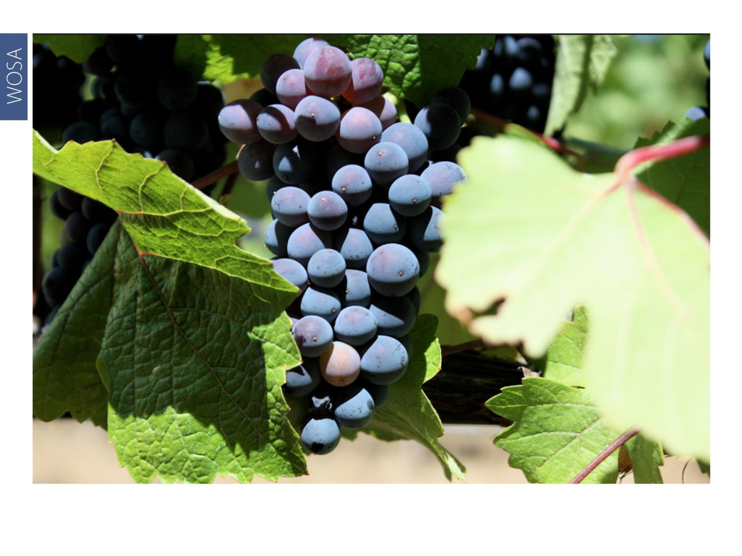
WOSA
Notes:
It seems there’s a growing realisation among those brave enough to tackle this fickle grape that, if they are to achieve success, site selection must be astute, and viticulture and winemaking meticulous.

Slide 14
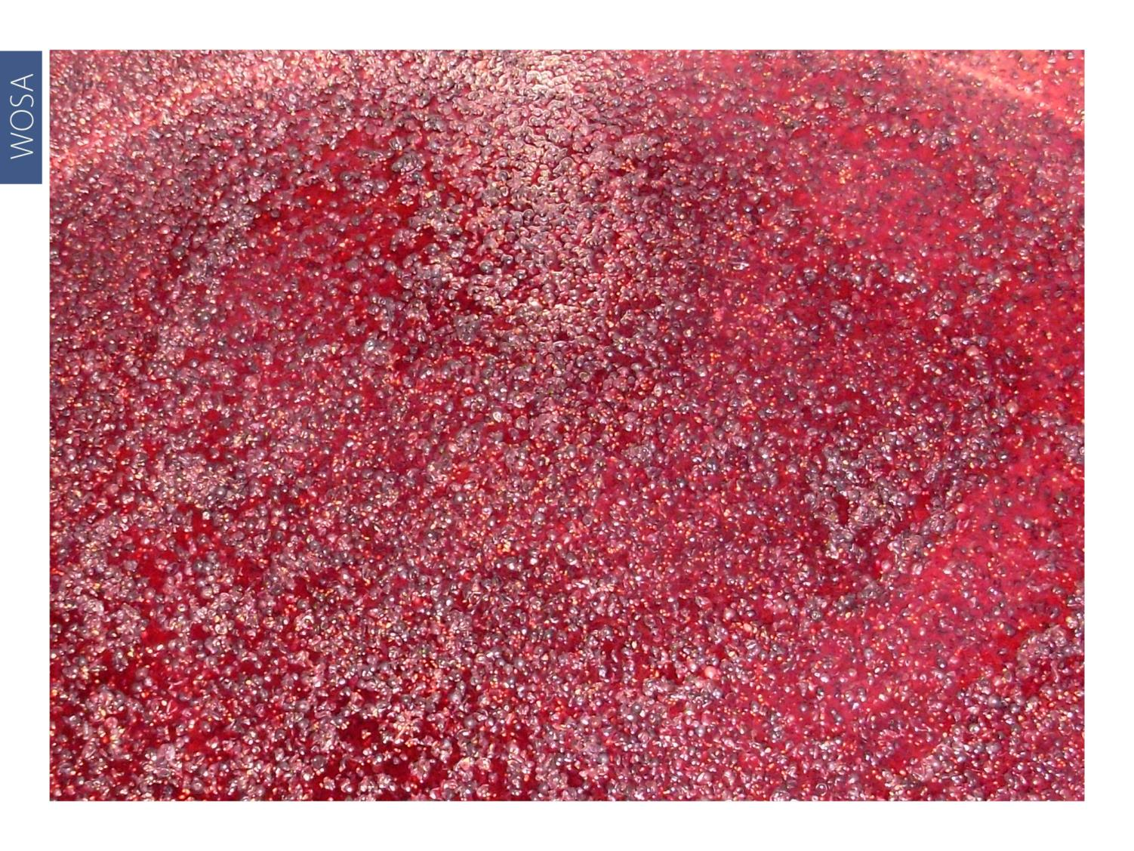
WOSA
Notes:
Pinot Noir wines tend to be lighter in colour than other red wines with pronounced cherry and berry flavours and aromas. They often present an earthy undertone.

Slide 15
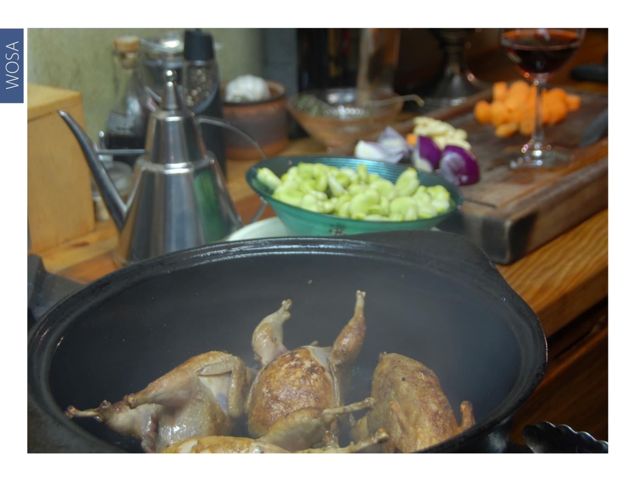
WOSA
Notes:
Pinot Noir pairs brilliantly with mushrooms, truffles and vegetarian risottos, as well as lighter meat dishes featuring chicken, especially coq au vin made with Pinot, quail, duck, guinea fowl or veal.

Slide 16
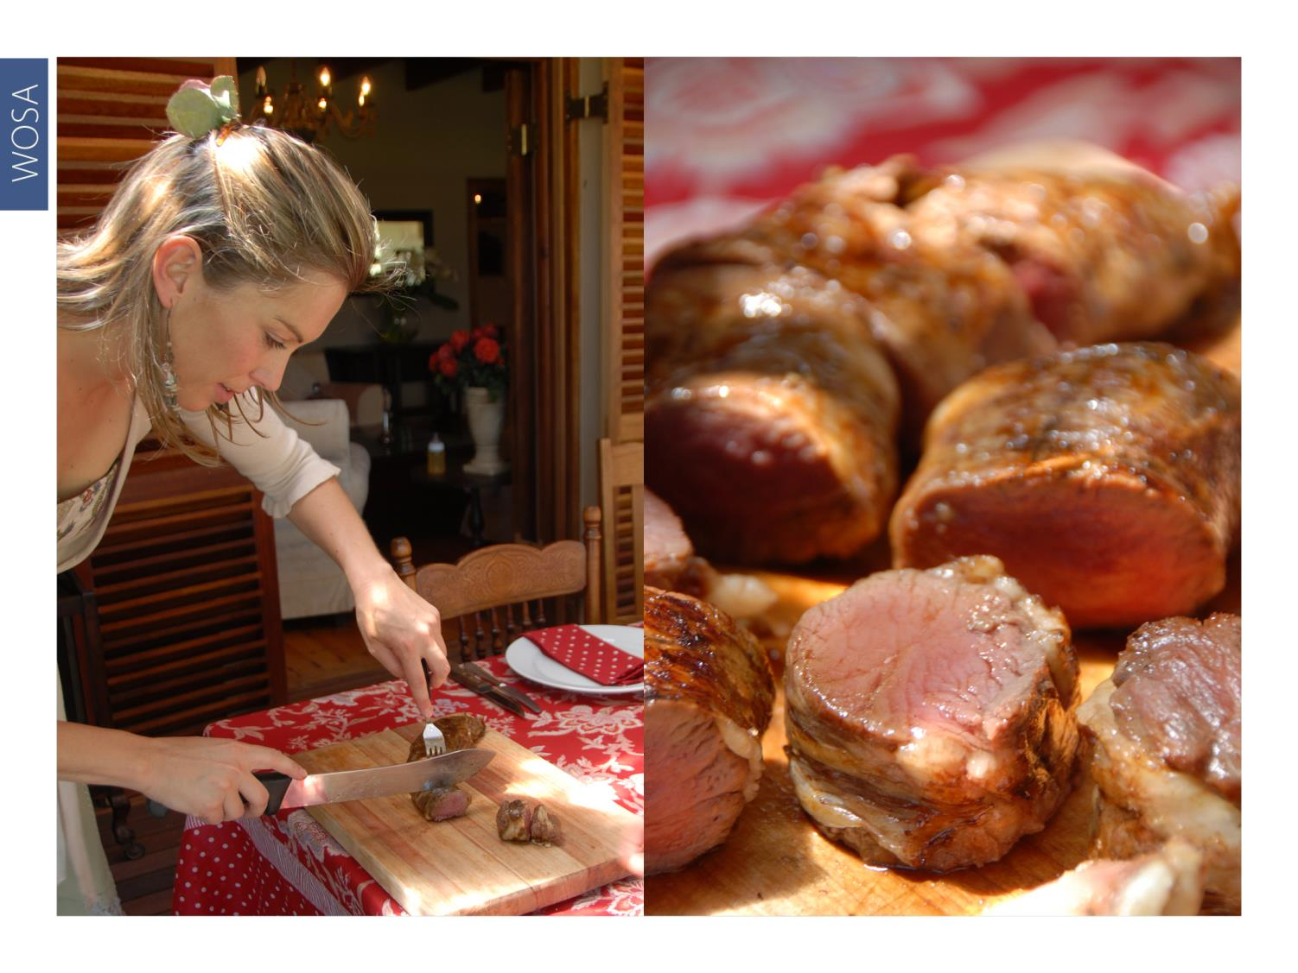
WOSA
Notes:
Pinot is also an excellent match for Karoo lamb, butterflied on the coals or slow-roasted in the oven; as well as springbok loin fillet, pan-seared as medallions or done whole on the braai.

Slide 17
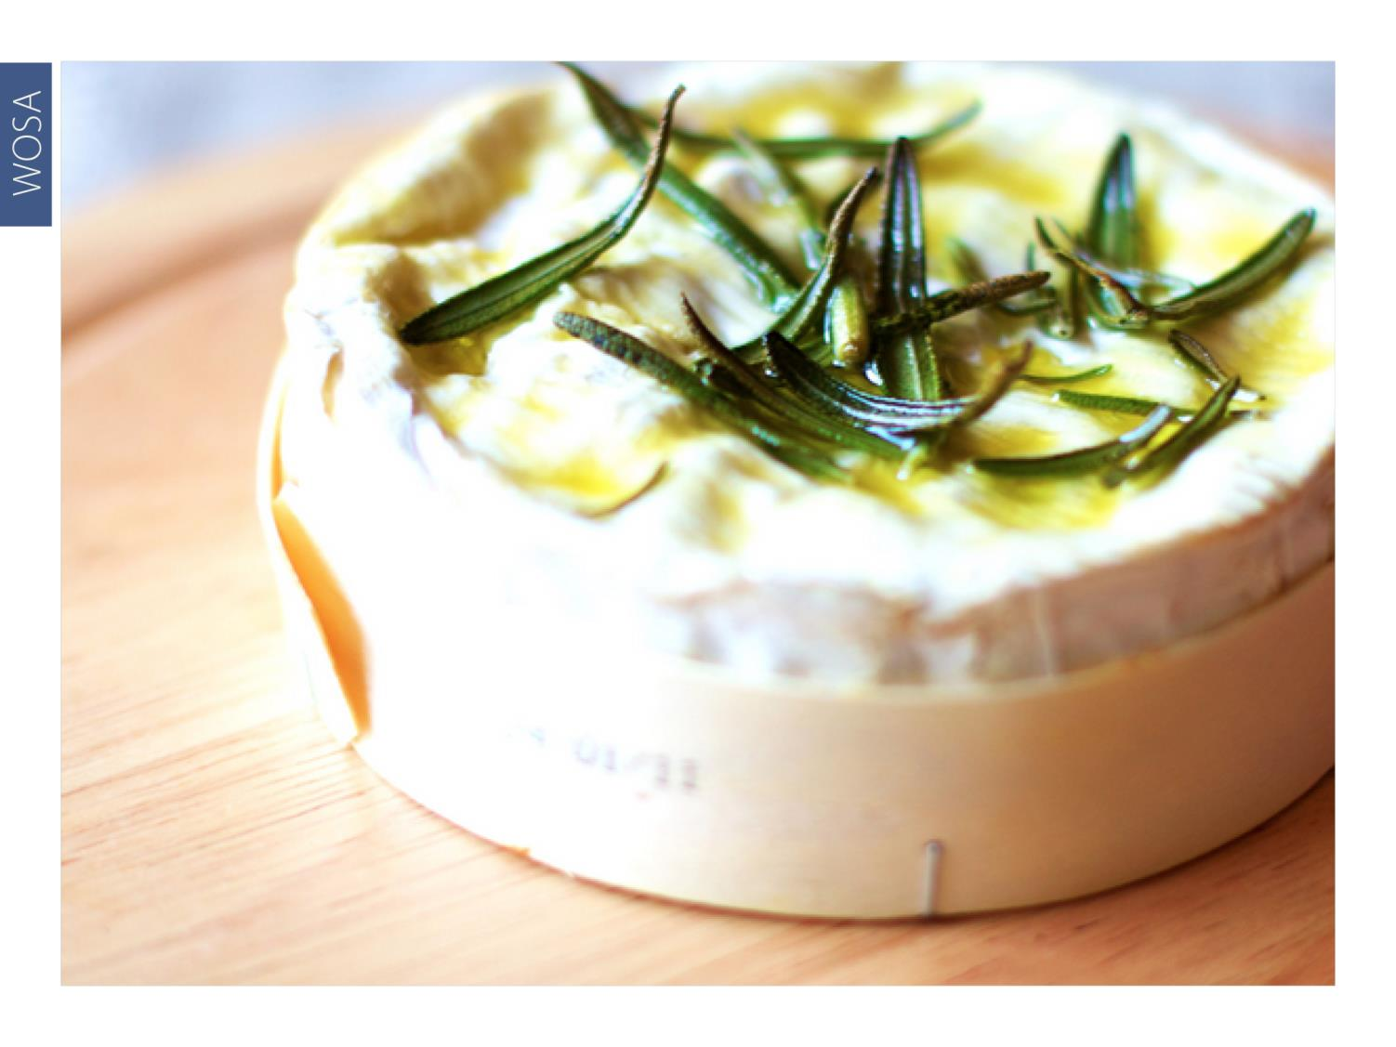
WOSA
Notes:
Brie, camembert and mild blue cheese partner well with Pinot too.

Slide 18
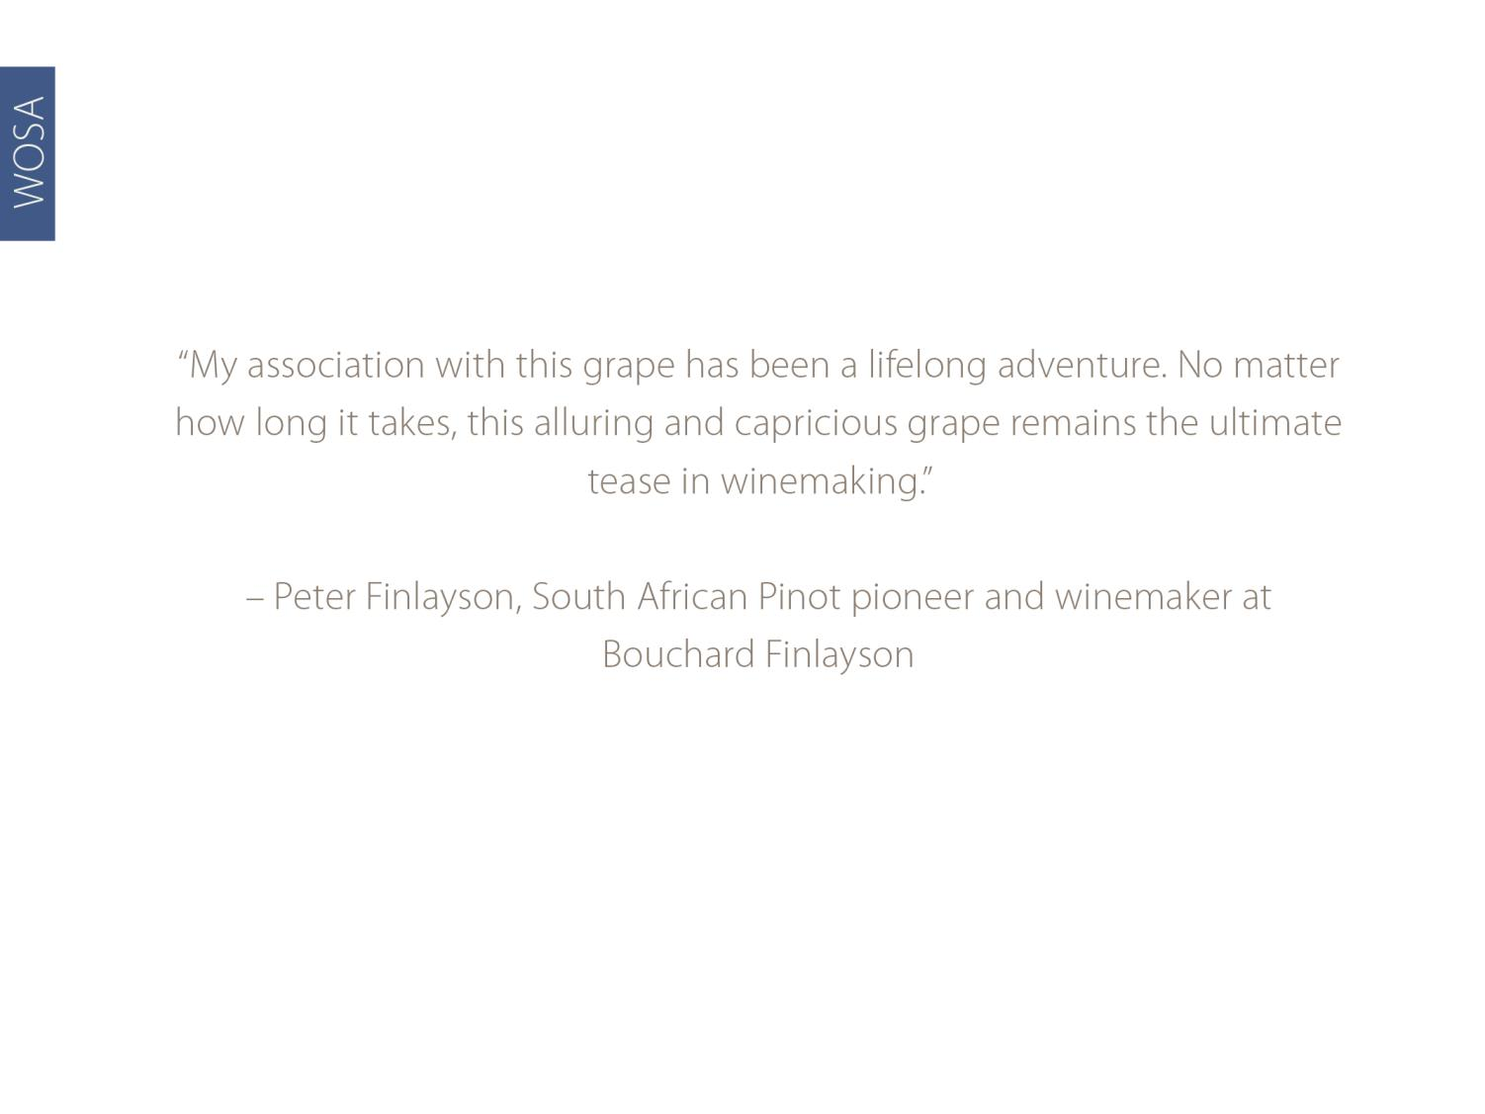
WOSA

Slide 19
WOSA
THE END

